Slide 1


Automating Builds for Enterprise JavaScript Applications
Esri Developer Summit
March 8–11, 2016 | Palm Springs, CA
George Bochenek
Randy Jones
Notes:
Good Afternoon,
I’m George Bochenek and this is Randy Jones. We work in Professional Services out of Washington DC. In that role, we end up working on a number of very large JavaScript applications. Over the course of working on these applications, we’ve found, there’s a definite need to put some care into the release process of your enterprise applications. Specifically, that means a stark difference between your dev environment, and what goes into

Slide 2


Production
Production
zedzap/8373720815
Notes:
Production. Production is a scary place. Generally you can assume a few things: people are going to be looking at your apps with sub optimal network connections. They’re probably using out of date browsers, and they’re going to be impatient. There’s only so long a loading bar can distract a user and app that takes forever.
A lot of times we think an app is ready to go when all the development is done and everything running as expected. That would be awesome, but there’s a lot that can be done after development is complete to improve performance and give your users the experience they expect.
So, how do we know what can be done?
There are a number of standard optimizations that can be done and I’ll get into that in a little bit. Most of the time, what I want is to just have something that tells me what I need to do, so I can live the good life.

Slide 3

Google PageSpeed
kubina/3813418796
Notes:
That’s where Google PageSpeed comes in.

Slide 4
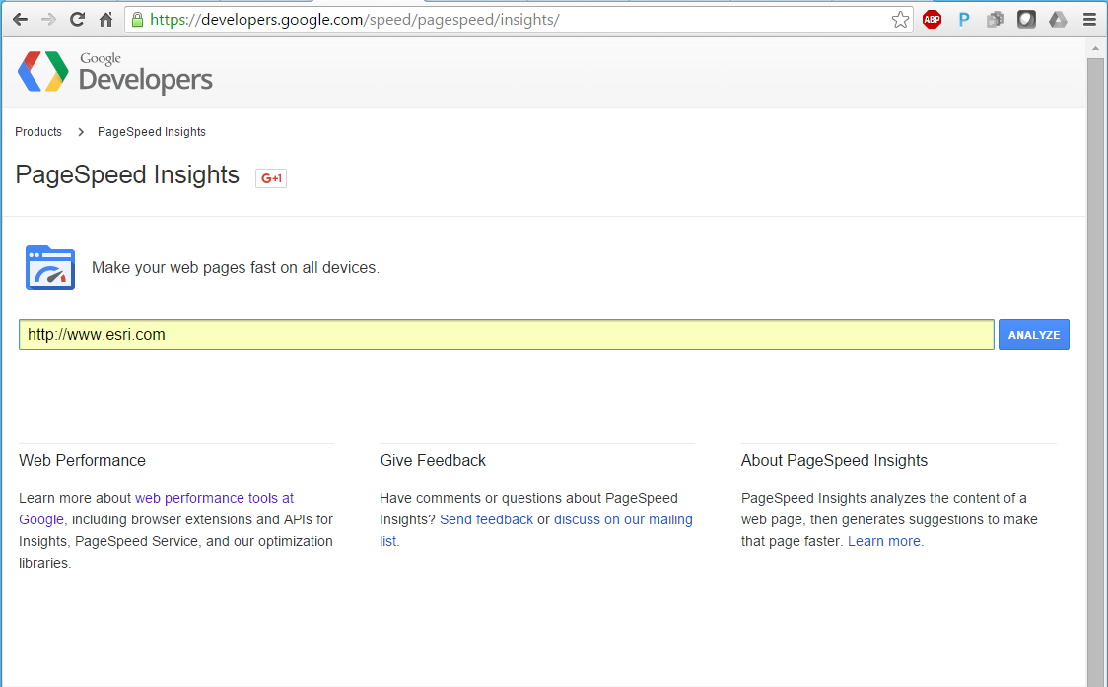
Notes:
If you put the url of a public site into page speed, it will give a bunch of ideas on how to improve the page, as well as ways to get there, and the potential savings that can be found in each step. There’s a lot of great documentation that Google packaged with the tool as well

Slide 5
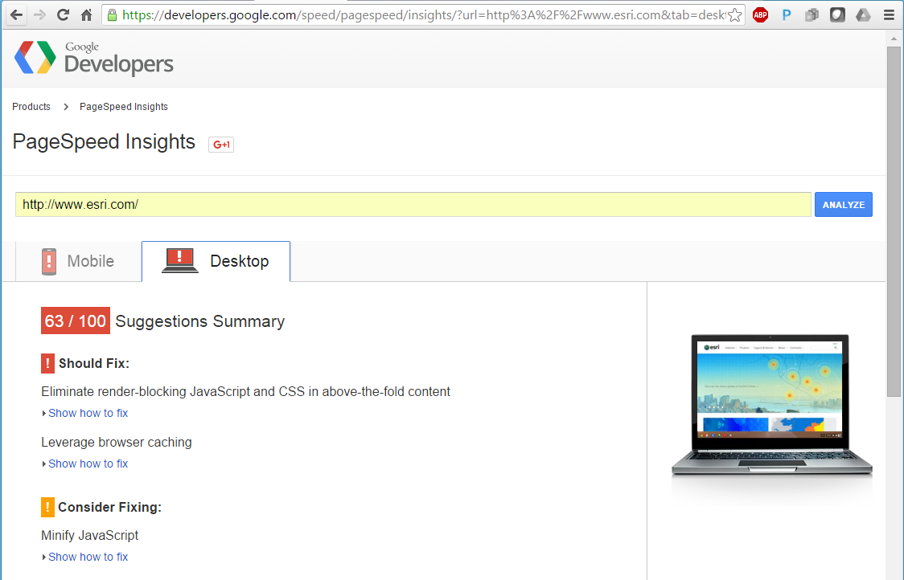
Notes:
Here’s what happens when we enter esri.com.
There are a few fixes it recommends, broken out into mobile and desktop sections. Pretty cool.
Some of the standard optimizations can be done without running any analysis and are things we try to think about in the initial design faces of our applications. A lot of them are super easy to do, making it a no brainer.

Slide 6
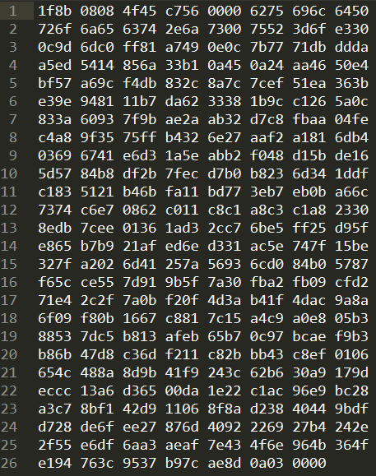
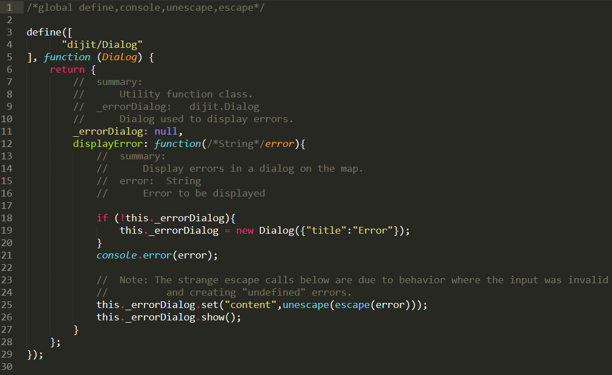
gzip is awesome
Notes:
The easiest and most straight forward way to get more performance is through compression. Every server should be configured to utilize Gzip or deflate to compress text files.
Every modern browser and web server supports gzip and deflate for text compression and it can reduce page size by up to 90%. This is a huge win for adding a couple lines to your server config. Up on the screen, you can see a really simple example of how that works. That little piece of code was reduced by 47%, from 778 bytes to 414. On a larger scale, we ran some analysis on a popular public facing mapping site without gzip and found enabling this one feature would reduce the overall page size by 228 KB or 79%. I can’t stress how big a win that is for such little set up. This can be enabled server-wide, so you don’t even have to think of it on a per app basis.
Next on our priority list is always to minify every last bit of CSS, JavaScript, and HTML. It’s amazing how much extra room white space, long variable names, and comments take up in our code. Even images can be minified or optimized.

Slide 7
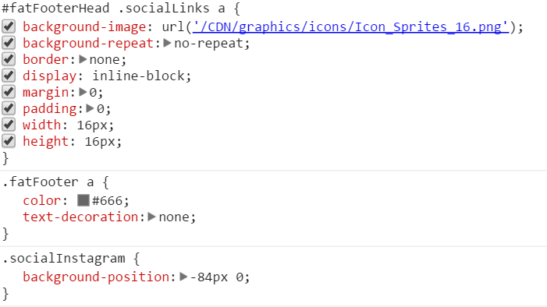

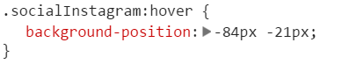
Image Optimization
Notes:
Often, the image resources we’re using as developers are much bigger than the actual display size of the page. Reducing the size of larger images and using lossless compression frees up even more room.
That covers how to make the loaded content smaller, but we can also load things in a smarter way to get performance increases. Each individual network call is a hit to performance. We can reduce some of these by combining a number of files. Images can be combined into one larger image called a sprite. By putting everything into one file and controlling width, height, and position through CSS, you can significantly lower the number of image calls.
Once all of our resources have been optimized, we can completely keep users from loading them over the network by leveraging browser caching. If those resources have the default cache settings increased, the user doesn’t have to make network calls at all. Mostly static resources can be cached for up to a year, while more frequently updated pages can be set to cache for a week or two weeks

Slide 8
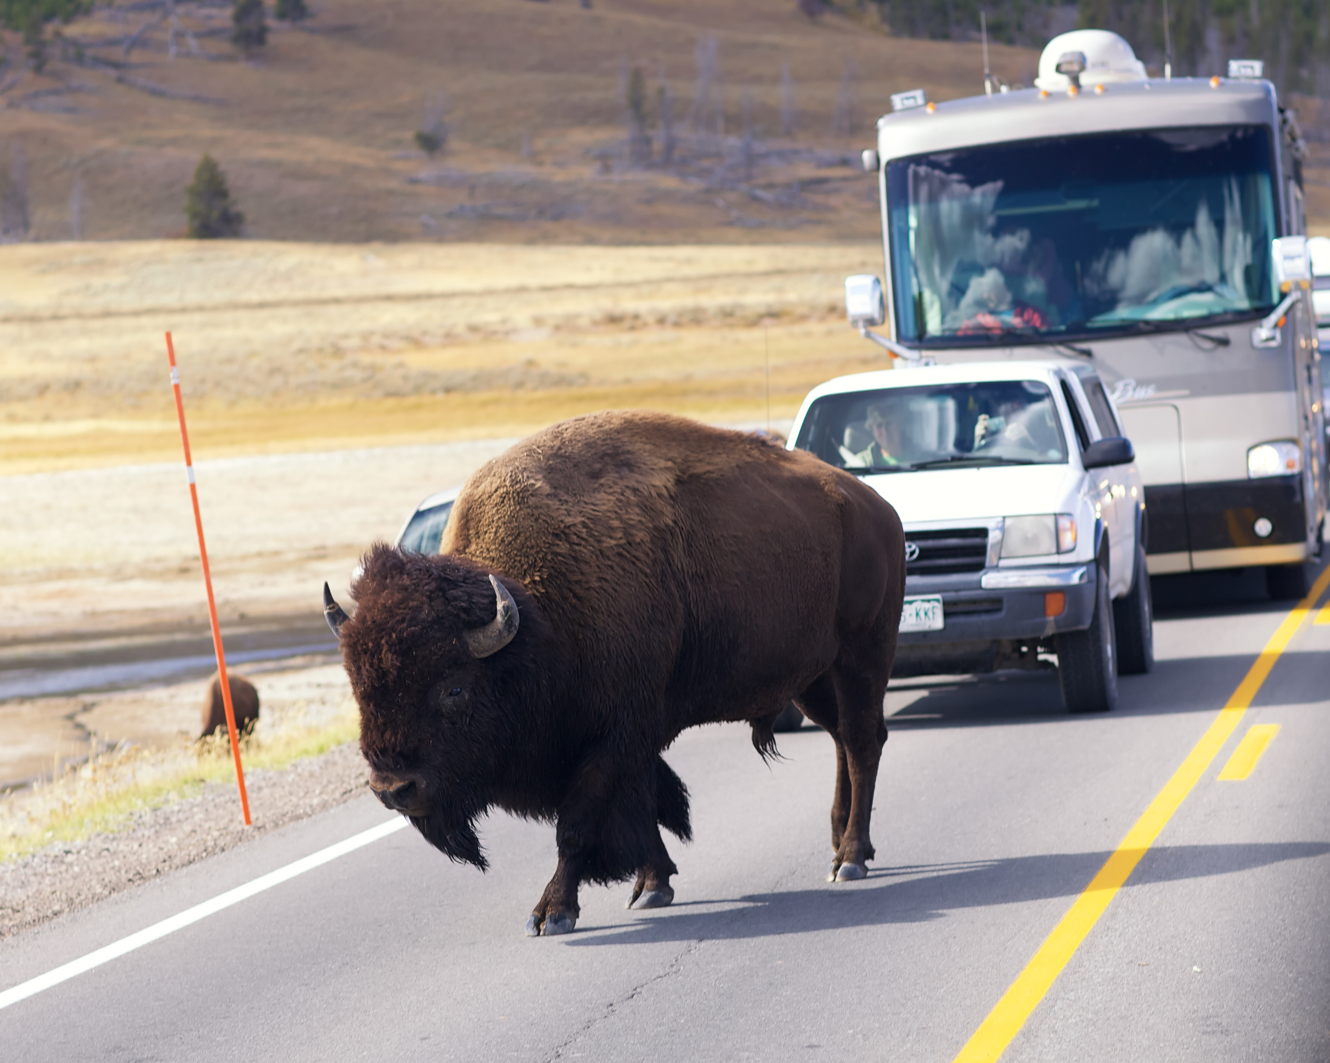
Blocking requests
dirtbikedba/3968410315
Notes:
Finally, we want to look at how the application is designed and the order in which everything is loaded.
Before the browser can render a page it has to build the DOM tree by parsing the HTML markup. During this process, whenever the parser encounters a script it has to stop, download the script, and execute it before it can continue parsing the HTML.. In order to give the user feedback quickly, applications should only load the necessary rendering information through blocking tags, instead loading code asynchronously or through lazy loading whenever possible.
This same concept applies to CSS. Before any structure can be rendered, the entire stylesheet needs to be loaded. To get around this, we can load our critical rendering information in separate inline blocks or smaller files. That way the bulk of our rendering can be done at load time.
Letting these non-critical scripts get off the road can give users a much more seamless experience and allow them to start using the application before all external resources have been loaded.

Slide 9


r_stephen/6906698996
Notes:
Out of all of the optimization tasks we’ve talked about, the largest difference we’ve seen when writing ESRI mapping applications is through minifying the code and combining the JavaScript API into our code base. The best way to do that is through the Dojo Build process.
Dojo provides a set of tools to help build applications using the frame work, which is everything developed using the ESRI JavaScript API. Basically the system scans your code, minifies everything, and pulls all AMD dependencies from require statements it sees into a single (or a few) layer files. In addition, any HTML templates will get pulled into that layer file as inline code.

Slide 10
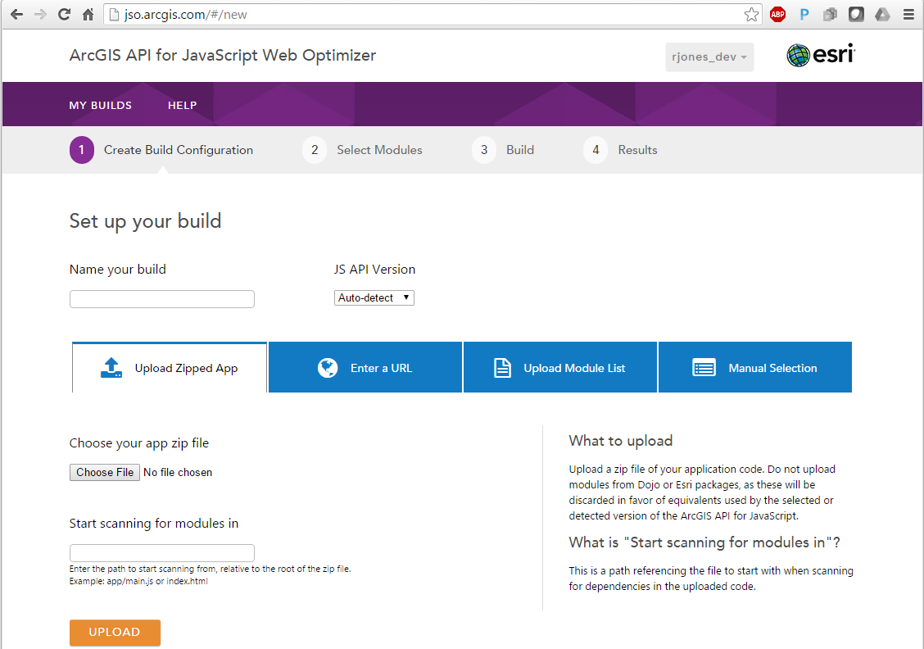
Notes:
One of the easiest ways to get a quick win and get most of the benefits of a Dojo build into an existing application, is by using the ArcGIS JavaScript Web Optimizer.
The optimizer lets you upload an application to the cloud and produce a build package containing all of the ESRI and Dojo dependencies in a minified layer file. I’ll usually use this tool for a low effort, but still major bump in performance to an application that’s either already deployed in production, or is really close to being completed.
It’s a great tool, but there are draw backs. Mainly, if an application is under continuous development, you’ll want to incorporate your build process into a continuous integration system and be able to test and modify the completed build on your own time and in different environments.
In order to get that kind of flexibility and responsiveness, we’ll use Bower to pull Dojo and the JavaScript onto our local machine. From there, we can run the dojo build using NodeJS on our own system, using all of our own code.
I’ll let Randy get into some more detail on that front.

Slide 11

Build Components
Notes:
Everything we’re going to use today to run the build will use NodeJS, so for our examples you’ll need to have node installed.
Lets look at the three requirements are to run a local dojo build.
The easiest way to get the build working for your project is to start with a good project structure. You want to have your javascript code organized into packages. Regardless if your project has a very flat folder structure or nested packages, the build will be able to work with either structure you’ve chosen.

Slide 12
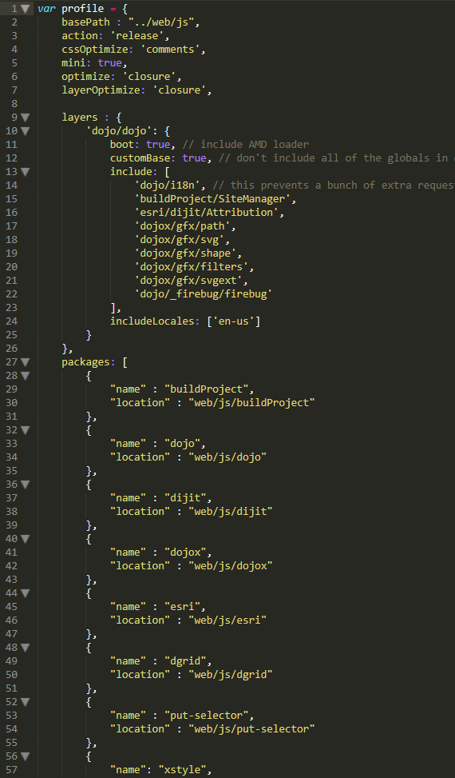
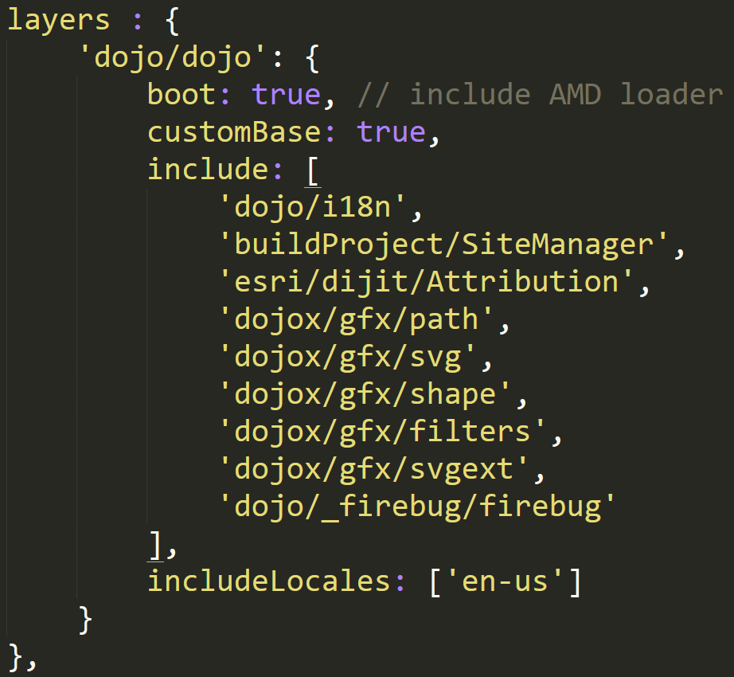
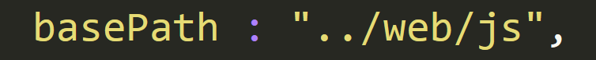
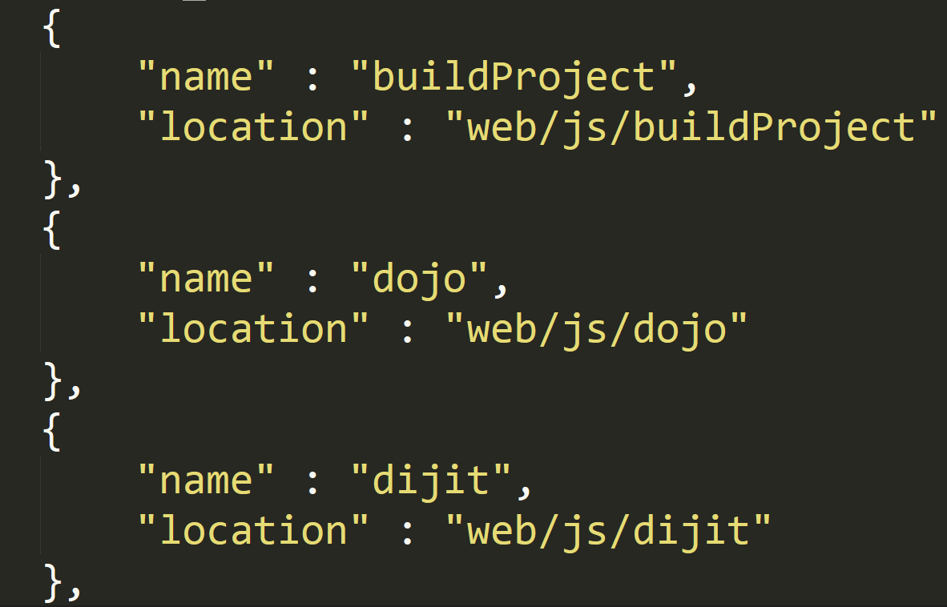
Notes:
Next we need to create a dojo build profile. This tells dojo what modules it needs to pull together for the build.
Lets look at the 3 aspects of this build file that you’ll most likely have to modify for your own project.
basePath which will be the location of all your JS code
Packages define what packages your project might depend on and dojo will build them
Layers –Here you’ll tell it your main classes, so if you have what you’ll see in our demo project a SiteManger or Controller class, you’ll list those out in the dojo profile and the build will figure out all the modules it depends on.
The next thing we need is the actual dojo and javascript api code to combine with our custom code, this leads us to dependency management.

Slide 13

Bower
A package manager for the web
http://bower.io
Notes:
While dependency management isn’t integral for us to do a dojo build, using Bower for dependency management is probably the easiest way for us to get dojo and the javascript api. Bower allows us to pull any of the javascript api 3.14 and later versions and associated patched versions of dojo directly from github without downloading zip files, extracting them correctly, remembering what version they are etc.

Slide 14
npm install –g bower
bower install arcgis-js-api --save-dev
bower install Esri/arcgis-js-api#3.16.0 --save-dev
Notes:
To add Bower to your project you’ll need node and you can install with a simple npm install –g bower.
Then you can run bower install <registered package>, github repo, or full git url. This will result in the creation of a bower.json file of all the dependencies within your project.
The good news if you’re in a disconnected environment that if you go through the effort to get the node packages like Bower, you can still use them with either a local git or have zip urls which bower will download and automatically extract.

Slide 15
{
"name": "EnterpriseJSApp",
"version": "1.0.0",
"dependencies": {},
"devDependencies": {
"dojo": "Esri/dojo#v1.10.4/esri-3.14.0",
"dijit": "Esri/dijit#v1.10.4/esri-3.14.0",
"dojox": "Esri/dojox#v1.10.4/esri-3.14.0",
"dgrid": "Esri/dgrid#0.3.17/esri-3.14.0",
"xstyle": "Esri/xstyle#0.1.3/esri-3.14.0",
"util": "Esri/dojo-util#v1.10.4/esri-3.14.0",
"dstore": "#v1.1.0",
"put-selector": "#0.3.6",
"esri": "Esri/arcgis-js-api#3.16.0"
},
"resolutions": {
"dojo": "v1.10.4/esri-3.16.0"
}
}
bower.json
Notes:
If you’re starting a new project and adding dependencies you can simply add them by running bower install and the registered name, git url, github project and tag or even the url to a zip. This will add an entry to the bower.json. Here’s an example of an existing project’s bower.json
In this project we can see the javascript api is pulled listed at the bottom of the devDependencies and we have the rest of the dojo toolkit, dstore, and other libraries that the ArcGIS API for JavaScript ususally hosts on the cdn. Also notice that we are pointing at specific tags in git to ensure we get the correct, patched version of dojo to go with the latest version of the javascript api.
You'll also notice I've added a .bowerrc file this is because I decided that instead of bower's default location I wanted the jsapi, dojo, etc to cohabitate with my modules. We can see now in my local web/js folder I have dojo, esri, and the other modules I'll need for a build.

Slide 16
{
"directory": "web/js"
}
.bowerrc
Notes:
You'll also notice I've added a .bowerrc file this is because I decided that instead of bower's default location I wanted the jsapi, dojo, etc to cohabitate with my modules. We can see now in my local web/js folder I have dojo, esri, and the other modules I'll need for a build.

Slide 17




Build Automation
Notes:
While we could run the dojo build from a shell or batch file on the command line, there is a lot more value, especially when we’re talking about enterprise development to integrate this process into a build automation. Last year we did a similar presentation where our demo used Apache Ant to run the dojo build and this year we’ve updated the demo to use Grunt. While Grunt has become a popular choice for task and build automation in JavaScript, you don’t have to switch to it in order to get the benefits of a Dojo build. As I mentioned last year we used Ant and I’ve seen blog posts about doing dojo builds from maven and Gulp is somewhat similar to Grunt. So whether you want to stick with what your comfortable with explore something new you can still get the production benefits of building your application with the dojo build system.

Slide 18
npm install –g grunt-cli
npm install grunt-dojo --save-dev
npm install grunt-replace --save-dev
Notes:
Like bower grunt is extremely easy to install and use once you have node installed. All we have to do is run npm install –g grunt-cli and we’re ready to run or create grunt projects.
Grunt has a great ecosystem of tasks already written and are easy for you to add to a project.
To install grunt tasks we also run npm install commands. Here’s an example of how we’d install the grunt-dojo task, which we’ll use to run our build and just a grunt replace to replace text within files.

Slide 19
{
"name": "enterprise-test-sample",
"version": "1.0.0",
"description": “…
"main": "Gruntfile.js",
"devDependencies": {
"grunt": "^0.4.5",
"grunt-contrib-clean": "^1.0.0",
"grunt-contrib-copy": "^1.0.0",
"grunt-dojo": "^1.1.1",
"grunt-karma": "^0.12.1",
"grunt-replace": "^0.11.0",
"karma": "^0.13.22",
"karma-chrome-launcher": "^0.1.4",
"karma-dojo": "0.0.1",
"karma-jasmine": "^0.1.5",
"karma-junit-reporter": "^0.3.8"
}
}
package.json
npm install
Notes:
So by doing –save-dev node creates and adds entries to the package.json so that we know all the things this project is dependent on.
When the project is checked out from source control, all the developer has to do is run npm install and they’ll get all the dependencies needed in one easy step. And remember this file can be copied between projects, you don’t have to start it from scratch.

Slide 20
Sample Project
https://github.com/Esri/enterprise-build-sample-js
Notes:
So we’re going to run the dojo build from grunt for this demo, lets go start looking at our project.

Slide 21

Continuous Integration

Slide 22
What about…
Web App Builder?
Notes:
Thanks Randy. Usually when we get into conversations about building apps, I hear something like that’s great George, but how do I get this to work with…
Web app builder. It turns out its really easy.
DEMODEMODEMO

Slide 23
Try it out:
https://github.com/gbochenek/web-app-builder-build
Notes:
This sample app is available on GitHub right now, so please feel free to pull it down, try it out on your own apps, and let us know

Slide 24
JavaScript Applications for the Enterprise: Test More, Work Less
Friday 8:30-9:30
1:00-2:00
Primrose B
https://github.com/gbochenek/web-app-builder-build
https://github.com/Esri/enterprise-build-sample-js

Slide 25




